Slide 1
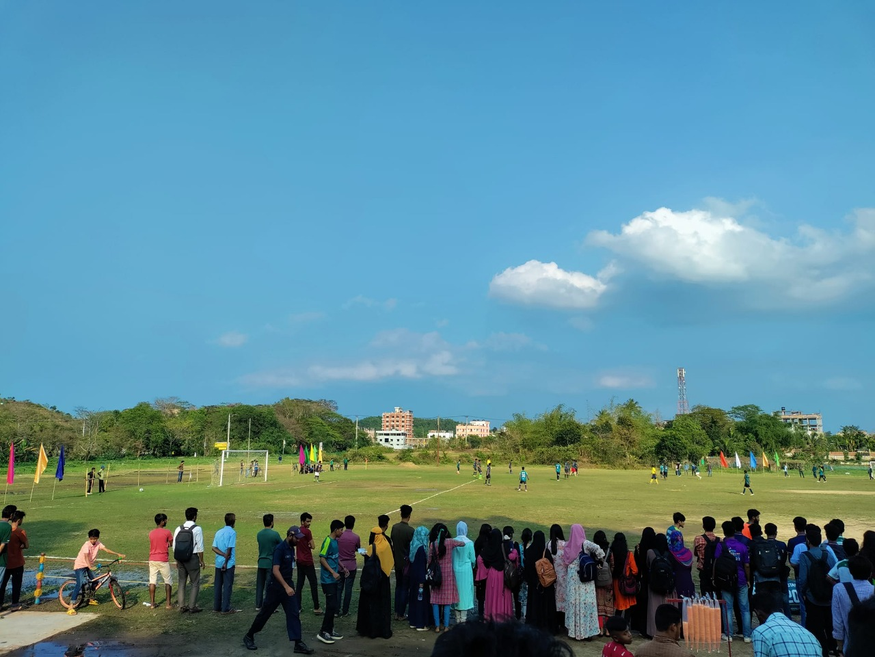


Shahjalal University of Science and
Technology
Department of Statistics
League Pro Database Management System
Submitted By:
MD Salek Miah (2021134066)
Sourav Ahmed (2021134068)
Database Management System Lab Fall 2025
Ishtiaque Zahid
March 28, 2025
Course: Semester: Submitted To: Submission Date:

Slide 2
Contents
Introduction 1
Project Overview .................................................................................................... 1
Objectives............................................................................................................... 1
Database Design 2
Entity-Relationship Diagram................................................................................... 2
Relational Schema ...................................................................................................3
Normalization Process ............................................................................................ 3
Implementation 4
SQL Queries ............................................................................................................4
Player Performance Analysis ...................................................................... 4
Team Statistics............................................................................................ 4
Referee Workload....................................................................................... 4
Department Budget Analysis....................................................................... 5
Player Age Distribution............................................................................... 5
3.2
Implementation Challenges ......................................................................................5
Challenge 1: Complex Relationship Management ....................................... 5
Solution:..................................................................................................... 5
Challenge 2: Performance Optimization...................................................... 5
Solution:..................................................................................................... 5
4 Conclusion
A Appendix A: Complete SQL Schema
6
8

Slide 3
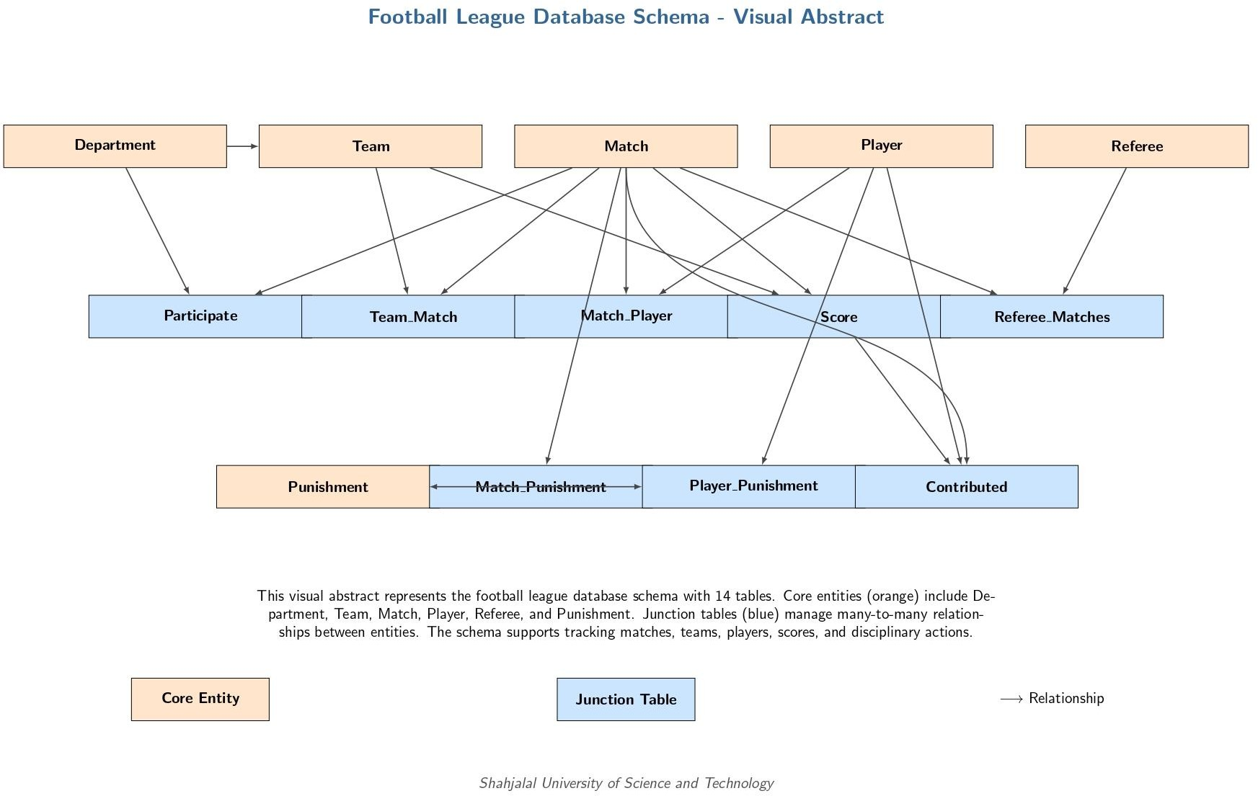
Abstract
The League Pro Database Management System is a comprehensive solution designed to manage professional sports league operations. This system efficiently handles player information, team compositions, match scheduling, referee assignments, and disciplinary actions. Developed as part of the Database Management System Lab course at Shahjalal University of Science and Technology, this project demonstrates the practical implementation of relational database concepts, including entity-relationship modeling, normalization, and complex query formulation. The system provides league administrators with powerful tools to track player statistics, manage team rosters, and analyze match outcomes while maintaining data integrity through carefully designed constraints and relationships.

Slide 4
Chapter 1
Introduction
Project Overview
The League Pro Database Management System is a centralized platform for managing all aspects of professional sports league administration. Our system addresses the critical needs of:
Player and team management
Match scheduling and tracking
Referee assignment and performance monitoring
Disciplinary action tracking
Statistical analysis and reporting
Developed at Shahjalal University of Science and Technology’s Department of Computer Science & Engineering, this project represents the culmination of our learning in database design and implementation.
Objectives
The primary objectives of this project include:
Designing a normalized database schema for league management
Implementing complex relationships between entities
Creating efficient query mechanisms for data retrieval
Ensuring data integrity through proper constraints
Providing comprehensive reporting capabilities
1

Slide 5
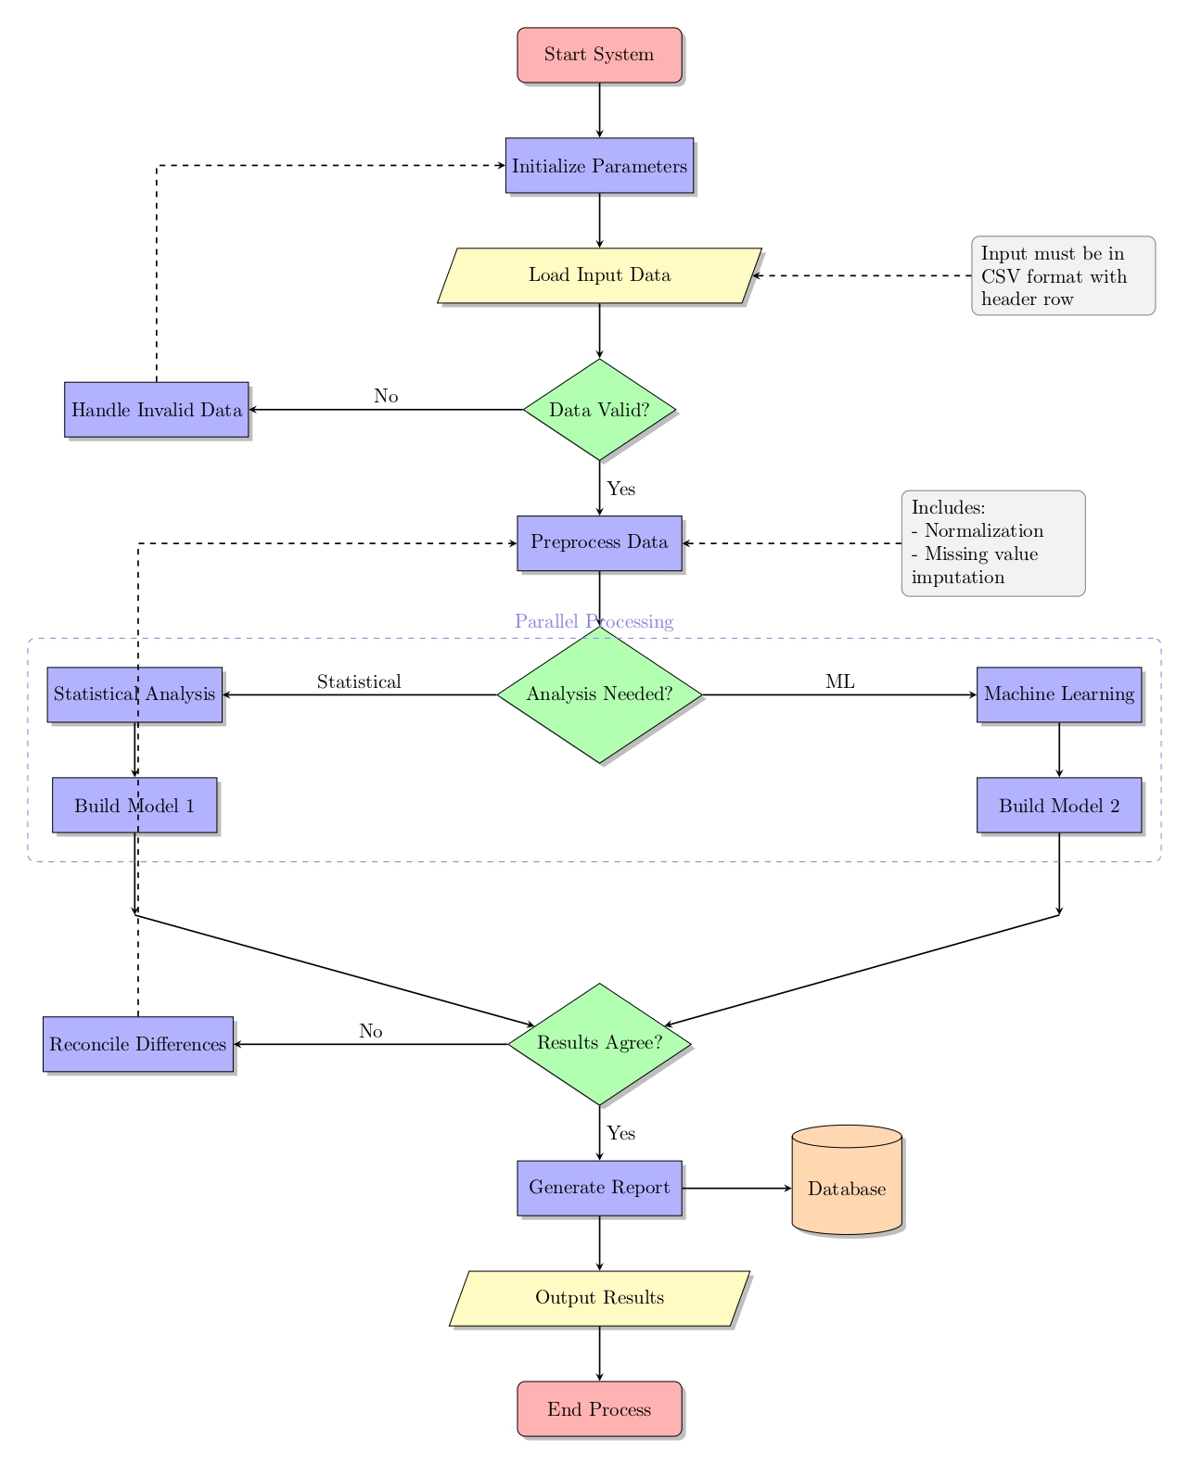
METHODOLOGY
2

Slide 6
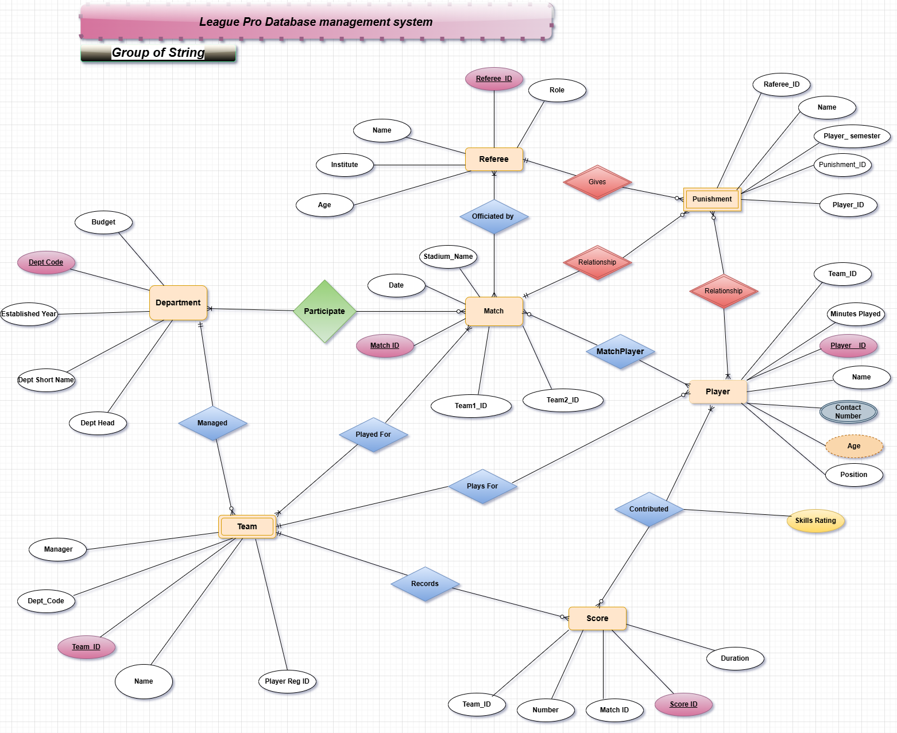
Chapter 2
Database Design
2.1 Entity-Relationship Diagram
Figure 2.1: Entity-Relationship Diagram of League Pro Database
1

Slide 7
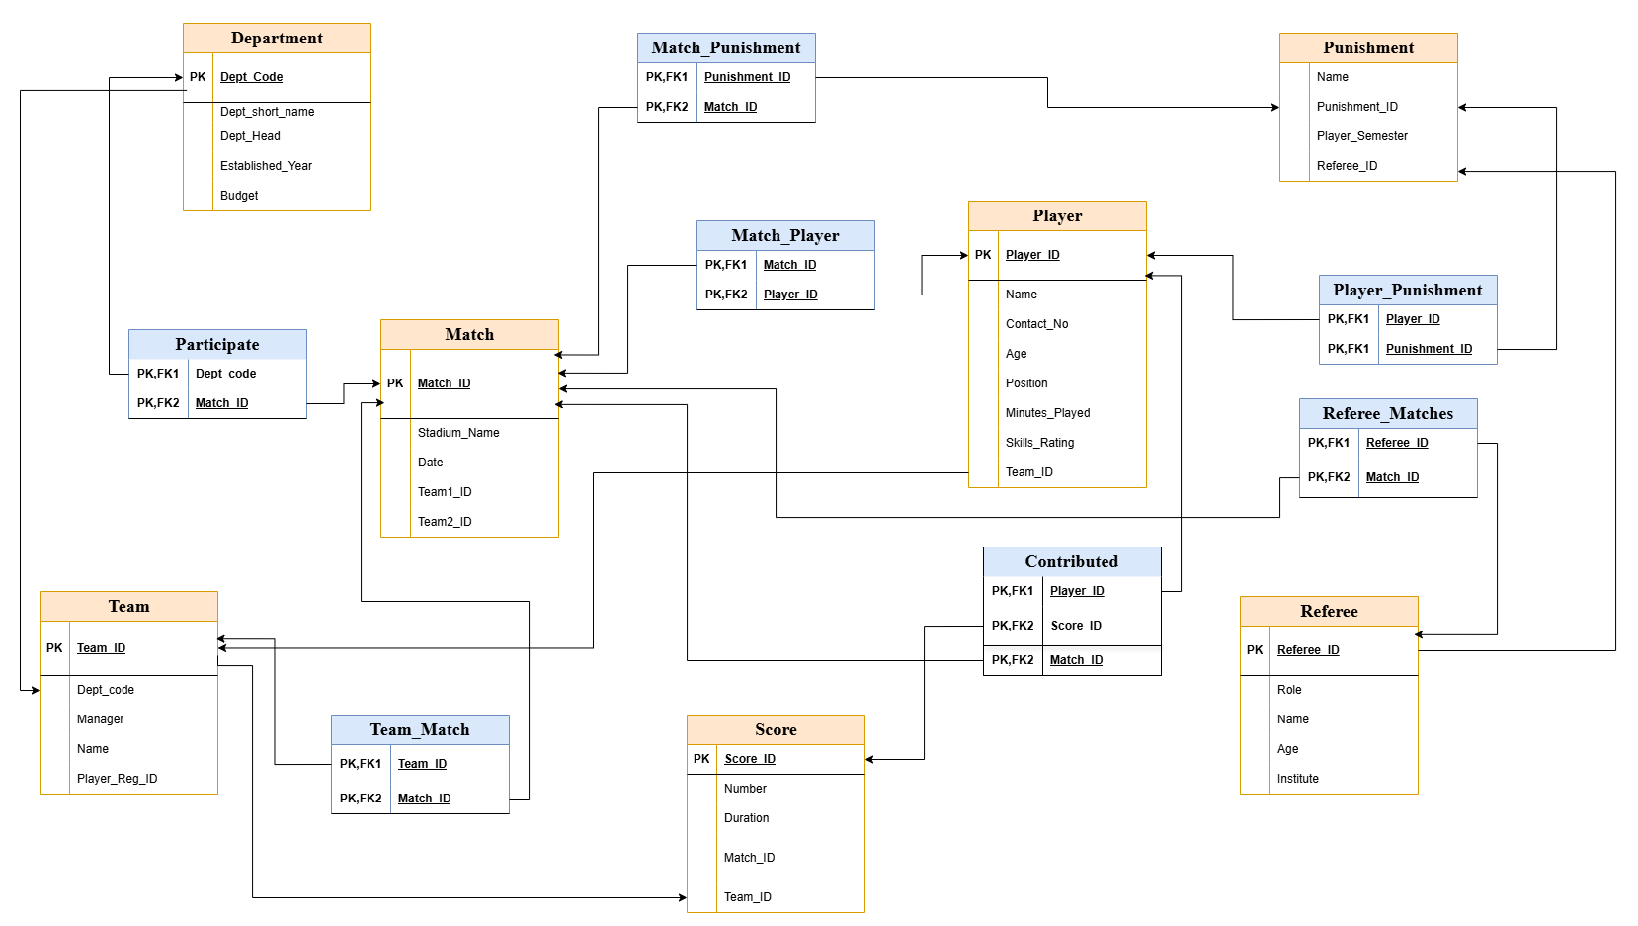
Chapter 2. Database Design
2.2 Relational Schema
3
Figure 2.2: Complete Relational Schema Diagram
Normalization Process
Our database design adheres to 3NF (Third Normal Form) with the following normalization steps:
Identification of all functional dependencies
Elimination of repeating groups (1NF)
Removal of partial dependencies (2NF)
Elimination of transitive dependencies (3NF)
4

Slide 8
Chapter 3
Implementation
SQL Queries
-- SQL file with five SELECT queries for the Football League Database
3.3
-- 1. Simple SELECT-FROM-WHERE query (no joins, no subqueries, no aggregates)
-- Query to find all players who are forwards and have a skills rating above 8.0
SELECT Player_ID, Name, Age, Skills_Rating, Team_ID
FROM Player
WHERE Position = 'Forward' AND Skills_Rating > 8.0;
3.9
-- 2. SELECT query using aggregate functions with GROUP BY
-- Query to find the total number of players in each team and their average skills rating
SELECT Team_ID, COUNT(*) AS NumberOfPlayers, AVG(Skills_Rating) AS AverageSkillsRating,
MAX(Skills_Rating) AS HighestSkillsRating
FROM Player
GROUP BY Team_ID
HAVING AVG(Skills_Rating) > 8.0;
3.17
-- 3. SELECT query using nested subqueries
-- Query to find all matches where the highest skilled player participated
SELECT m.Match_ID, m.Stadium_Name, m.Date, m.Team1_ID, m.Team2_ID
FROM `Match` m
WHERE m.Match_ID IN (
SELECT mp.Match_ID
FROM Match_Player mp
WHERE mp.Player_ID = (
SELECT p.Player_ID
FROM Player p
ORDER BY p.Skills_Rating DESC
LIMIT 1
3.30 )
3.31 );
3.32
3.33 -- 4. SELECT query using JOIN (First join query)

Slide 9
-- Query to find all punishments given in matches and the players who received them
SELECT m.Match_ID, m.Date, m.Stadium_Name, p.Name AS PlayerName,
pu.Name AS PunishmentType, pu.Player_Semester
FROM `Match` m
INNER JOIN Match_Punishment mp ON m.Match_ID = mp.Match_ID
INNER JOIN Punishment pu ON mp.Punishment_ID = pu.Punishment_ID
INNER JOIN Player_Punishment pp ON pu.Punishment_ID = pp.Punishment_ID
INNER JOIN Player p ON pp.Player_ID = p.Player_ID
ORDER BY m.Date, p.Name;
3.43
-- 5. SELECT query using JOIN (Second join query)
-- Query to find all matches with their scores, grouped by teams
SELECT t.Name AS TeamName, m.Match_ID, m.Date, m.Stadium_Name,
SUM(s.Number) AS TotalScore
FROM Team t
LEFT JOIN Team_Match tm ON t.Team_ID = tm.Team_ID
LEFT JOIN `Match` m ON tm.Match_ID = m.Match_ID
LEFT JOIN Score s ON (m.Match_ID = s.Match_ID AND t.Team_ID = s.Team_ID)
GROUP BY t.Name, m.Match_ID, m.Date, m.Stadium_Name
ORDER BY m.Date, t.Name;Implementation Challenges
Challenge 1: Complex Relationship Management
The many-to-many relationships between matches, teams, and players required careful junction table design. We initially struggled with maintaining referential integrity when deleting records.
Solution:
Implemented cascading updates but restricted cascading deletes, instead using application-level checks before deletion.
Challenge 2: Performance Optimization
Complex queries involving multiple joins initially had poor performance with large datasets.
Solution:
Created strategic indexes on frequently joined columns and optimized query structure.
6

Slide 10
Chapter 4
Conclusion
The League Pro Database Management System meets all specified requirements while demonstrating proper database design principles. Through this project, we’ve gained practical experience in:
Entity-Relationship modeling
Relational schema design creation and query optimization
Complex SQL query formulation
This project serves as a foundation for future enhancements, including:
Fan engagement modules
Advanced analytics dashboards
Mobile application integration
6

Slide 11
Bibliography
Shahjalal University of Science and Technology. (2023). Academic Regulations. Sylhet: SUST Press.
Elmasri, R., & Navathe, S. B. (2015). Fundamentals of Database Systems (7th ed.). Pearson.
Beaulieu, A. (2020). Learning SQL (3rd ed.). O’Reilly Media
4. Elmasri, R., Navathe, S.B. (2015). Fundamentals of Database Systems. 7th Edition. Pearson Education.
5. MySQL 8.0 Reference Manual (2023). Oracle Corporation.
6. Beaulieu, A. (2020). Learning SQL. 3rd Edition. O’Reilly Media.
7.Garcia-Molina, H. (2008). Database Systems: The Complete Book. 2nd Edition. Pearson.
7

Slide 12
Appendix A
Appendix A: Complete SQL Schema
-- Create and use the database
CREATE DATABASE IF NOT EXISTS football_league; USE football_league;
-- Create Department table
CREATE TABLE IF NOT EXISTS Department ( Dept_Code VARCHAR(10) PRIMARY KEY,
Dept_short_name VARCHAR(50) NOT NULL,
Dept_Head VARCHAR(100), Established_Year INT, Budget DECIMAL(12, 2)
);
-- Create Team table
CREATE TABLE IF NOT EXISTS Team ( Team_ID VARCHAR(10) PRIMARY KEY,
Dept_code VARCHAR(10), Manager VARCHAR(100),
Name VARCHAR(100) NOT NULL,
Player_Reg_ID VARCHAR(20),
FOREIGN KEY (Dept_code) REFERENCES Department(Dept_Code)
8

Slide 13
);
-- Create Match table
CREATE TABLE IF NOT EXISTS `Match` ( Match_ID VARCHAR(10) PRIMARY KEY,
Stadium_Name VARCHAR(100), Date DATE,
Team1_ID VARCHAR(10), Team2_ID VARCHAR(10),
FOREIGN KEY (Team1_ID) REFERENCES Team(Team_ID),
FOREIGN KEY (Team2_ID) REFERENCES Team(Team_ID)
);
-- Create Participate table (junction table between Department and Match)
CREATE TABLE IF NOT EXISTS Participate (
Dept_code VARCHAR(10), Match_ID VARCHAR(10),
PRIMARY KEY (Dept_code, Match_ID),
FOREIGN KEY (Dept_code) REFERENCES Department(Dept_Code), FOREIGN KEY (Match_ID) REFERENCES `Match`(Match_ID)
);
-- Create Team_Match table (junction table between Team and Match)
CREATE TABLE IF NOT EXISTS Team_Match ( Team_ID VARCHAR(10),
Match_ID VARCHAR(10),
PRIMARY KEY (Team_ID, Match_ID),

Slide 14
FOREIGN KEY (Team_ID) REFERENCES Team(Team_ID),
FOREIGN KEY (Match_ID) REFERENCES `Match`(Match_ID)
);
-- Create Player table
CREATE TABLE IF NOT EXISTS Player ( Player_ID VARCHAR(10) PRIMARY KEY, Name VARCHAR(100) NOT NULL,
Contact_No VARCHAR(15), Age INT,
Position VARCHAR(50), Minutes_Played INT, Skills_Rating DECIMAL(3, 1), Team_ID VARCHAR(10),
FOREIGN KEY (Team_ID) REFERENCES Team(Team_ID)
);
-- Create Match_Player table (junction table between Match and Player)
CREATE TABLE IF NOT EXISTS Match_Player ( Match_ID VARCHAR(10),
Player_ID VARCHAR(10),
PRIMARY KEY (Match_ID, Player_ID),
FOREIGN KEY (Match_ID) REFERENCES `Match`(Match_ID), FOREIGN KEY (Player_ID) REFERENCES Player(Player_ID)
);
-- Create Score table
CREATE TABLE IF NOT EXISTS Score (
1

Slide 15
Score_ID VARCHAR(10) PRIMARY KEY,
Number INT, Duration INT,
Match_ID VARCHAR(10), Team_ID VARCHAR(10),
FOREIGN KEY (Match_ID) REFERENCES `Match`(Match_ID), FOREIGN KEY (Team_ID) REFERENCES Team(Team_ID)
);
-- Create Contributed table (junction table between Player and Score)
CREATE TABLE IF NOT EXISTS Contributed ( Player_ID VARCHAR(10),
Score_ID VARCHAR(10),
Match_ID VARCHAR(10),
PRIMARY KEY (Player_ID, Score_ID),
FOREIGN KEY (Player_ID) REFERENCES Player(Player_ID), FOREIGN KEY (Score_ID) REFERENCES Score(Score_ID), FOREIGN KEY (Match_ID) REFERENCES `Match`(Match_ID)
);
-- Create Referee table
CREATE TABLE IF NOT EXISTS Referee ( Referee_ID VARCHAR(10) PRIMARY KEY, Role VARCHAR(50),
Name VARCHAR(100) NOT NULL, Age INT,
Institute VARCHAR(100)
);

Slide 16
-- Create Referee_Matches table (junction table between Referee and Match)
CREATE TABLE IF NOT EXISTS Referee_Matches ( Referee_ID VARCHAR(10),
Match_ID VARCHAR(10),
PRIMARY KEY (Referee_ID, Match_ID),
FOREIGN KEY (Referee_ID) REFERENCES Referee(Referee_ID), FOREIGN KEY (Match_ID) REFERENCES `Match`(Match_ID)
);
-- Create Punishment table
CREATE TABLE IF NOT EXISTS Punishment ( Punishment_ID VARCHAR(10) PRIMARY KEY, Name VARCHAR(100) NOT NULL,
Player_Semester VARCHAR(20),
Referee_ID VARCHAR(10),
FOREIGN KEY (Referee_ID) REFERENCES Referee(Referee_ID)
);
-- Create Match_Punishment table (junction table between Match and Punishment)
CREATE TABLE IF NOT EXISTS Match_Punishment ( Match_ID VARCHAR(10),
Punishment_ID VARCHAR(10),
PRIMARY KEY (Match_ID, Punishment_ID),
FOREIGN KEY (Match_ID) REFERENCES `Match`(Match_ID), FOREIGN KEY (Punishment_ID) REFERENCES
Punishment(Punishment_ID)
);
1

Slide 17
-- Create Player_Punishment table (junction table between Player and Punishment)
CREATE TABLE IF NOT EXISTS Player_Punishment ( Player_ID VARCHAR(10),
Punishment_ID VARCHAR(10),
PRIMARY KEY (Player_ID, Punishment_ID),
FOREIGN KEY (Player_ID) REFERENCES Player(Player_ID),
FOREIGN KEY (Punishment_ID) REFERENCES
Punishment(Punishment_ID)
);
-- Insert sample data
-- Insert into Department
INSERT INTO Department VALUES ('D001', 'CS', 'Dr. James Smith', 1985, 120000.00);
INSERT INTO Department VALUES ('D002', 'ENG', 'Dr. Lisa Johnson', 1990, 110000.00);
INSERT INTO Department VALUES ('D003', 'BUS', 'Dr. Robert Williams', 1988, 130000.00);
INSERT INTO Department VALUES ('D004', 'MED', 'Dr. Sarah Davis', 1992, 150000.00);
-- Insert into Team
INSERT INTO Team VALUES ('T001', 'D001', 'Mike Anderson', 'CS Tigers', 'PR001');
INSERT INTO Team VALUES ('T002', 'D002', 'Emily Wilson',
'Engineering Eagles', 'PR002');
INSERT INTO Team VALUES ('T003', 'D003', 'Daniel Martin',
'Business Bulls', 'PR003');
INSERT INTO Team VALUES ('T004', 'D004', 'Julia Garcia',
'Medical Mavericks', 'PR004');

Slide 18
INSERT INTO Team VALUES ('T005', 'D001', 'Alex Thompson', 'CS
Panthers', 'PR005');
-- Insert into Match
INSERT INTO `Match` VALUES ('M001', 'Central Stadium', '2024-10- 01', 'T001', 'T002');
INSERT INTO `Match` VALUES ('M002', 'University Arena', '2024- 10-08', 'T003', 'T004');
INSERT INTO `Match` VALUES ('M003', 'Sports Complex', '2024-10- 15', 'T001', 'T003');
INSERT INTO `Match` VALUES ('M004', 'Olympic Field', '2024-10- 22', 'T002', 'T004');
INSERT INTO `Match` VALUES ('M005', 'Victory Stadium', '2024-10- 29', 'T005', 'T004');
-- Insert into Participate
INSERT | INTO | Participate | VALUES | ('D001', | 'M001');
INSERT | INTO | Participate | VALUES | ('D002', | 'M001');
INSERT | INTO | Participate | VALUES | ('D003', | 'M002');
INSERT | INTO | Participate | VALUES | ('D004', | 'M002');
INSERT | INTO | Participate | VALUES | ('D001', | 'M003');
INSERT | INTO | Participate | VALUES | ('D003', | 'M003');
-- Insert into Team_Match
INSERT | INTO | Team_Match | VALUES | ('T001', | 'M001');
INSERT | INTO | Team_Match | VALUES | ('T002', | 'M001');
INSERT | INTO | Team_Match | VALUES | ('T003', | 'M002');
INSERT | INTO | Team_Match | VALUES | ('T004', | 'M002');
INSERT | INTO | Team_Match | VALUES | ('T001', | 'M003');
INSERT | INTO | Team_Match | VALUES | ('T003', | 'M003');
INSERT | INTO | Team_Match | VALUES | ('T005', | 'M005');
1

Slide 19
INSERT INTO Team_Match VALUES ('T004', 'M005');
-- Insert into Player
INSERT INTO Player VALUES ('P001', 'John Smith', '555-1234', 20, 'Forward', 120, 8.5, 'T001');
INSERT INTO Player VALUES ('P002', 'David Jones', '555-2345', 21, 'Midfielder', 90, 7.8, 'T001');
INSERT INTO Player VALUES ('P003', 'Michael Brown', '555-3456', 22, 'Defender', 180, 8.2, 'T001');
INSERT INTO Player VALUES ('P004', 'Chris Wilson', '555-4567', 20, 'Forward', 150, 9.0, 'T002');
INSERT INTO Player VALUES ('P005', 'Mark Taylor', '555-5678', 19, 'Goalkeeper', 180, 8.7, 'T002');
INSERT INTO Player VALUES ('P006', 'Paul White', '555-6789', 21, 'Defender', 160, 7.5, 'T002');
INSERT INTO Player VALUES ('P007', 'Steven Green', '555-7890', 22, 'Midfielder', 170, 8.9, 'T003');
INSERT INTO Player VALUES ('P008', 'Thomas Brown', '555-8901', 20, 'Forward', 130, 8.3, 'T003');
INSERT INTO Player VALUES ('P009', 'Kevin Miller', '555-9012', 23, 'Defender', 180, 7.9, 'T003');
INSERT INTO Player VALUES ('P010', 'Andrew Davis', '555-0123', 21, 'Goalkeeper', 180, 8.4, 'T004');
INSERT INTO Player VALUES ('P011', 'Robert Johnson', '555-1122', 22, 'Forward', 140, 8.6, 'T004');
INSERT INTO Player VALUES ('P012', 'Richard Lee', '555-2233', 20, 'Midfielder', 150, 7.7, 'T004');
INSERT INTO Player VALUES ('P013', 'Lucas Chen', '555-3344', 21, 'Forward', 135, 8.8, 'T005');
INSERT INTO Player VALUES ('P014', 'Jay Wilson', '555-4455', 22, 'Defender', 180, 8.1, 'T005');
INSERT INTO Player VALUES ('P015', 'Sam Harris', '555-5566', 20,
'Midfielder', 160, 7.9, 'T005');
-- Insert into Match_Player

Slide 20
INSERT | INTO | Match_Player | VALUES | ('M001', | 'P001');
INSERT | INTO | Match_Player | VALUES | ('M001', | 'P002');
INSERT | INTO | Match_Player | VALUES | ('M001', | 'P003');
INSERT | INTO | Match_Player | VALUES | ('M001', | 'P004');
INSERT | INTO | Match_Player | VALUES | ('M001', | 'P005');
INSERT | INTO | Match_Player | VALUES | ('M002', | 'P007');
INSERT | INTO | Match_Player | VALUES | ('M002', | 'P008');
INSERT | INTO | Match_Player | VALUES | ('M002', | 'P010');
INSERT | INTO | Match_Player | VALUES | ('M002', | 'P011');
INSERT | INTO | Match_Player | VALUES | ('M003', | 'P001');
INSERT | INTO | Match_Player | VALUES | ('M003', | 'P003');
INSERT | INTO | Match_Player | VALUES | ('M003', | 'P007');
INSERT | INTO | Match_Player | VALUES | ('M003', | 'P009');
INSERT | INTO | Match_Player | VALUES | ('M005', | 'P013');
INSERT | INTO | Match_Player | VALUES | ('M005', | 'P014');
INSERT | INTO | Match_Player | VALUES | ('M005', | 'P010');
INSERT | INTO | Match_Player | VALUES | ('M005', | 'P012');
-- Insert into Referee
INSERT INTO Referee VALUES ('R001', 'Main', 'James Wilson', 35, 'National Referee Association');
INSERT INTO Referee VALUES ('R002', 'Assistant', 'Mary Johnson', 32, 'State Referee Institute');
INSERT INTO Referee VALUES ('R003', 'Main', 'Robert Davis', 40, 'National Referee Association');
INSERT INTO Referee VALUES ('R004', 'Assistant', 'Jennifer Brown', 38, 'State Referee Institute');
INSERT INTO Referee VALUES ('R005', 'Main', 'William Clark', 36, 'National Referee Association');
-- Insert into Referee_Matches
1

Slide 21
INSERT | INTO | Referee_Matches | VALUES | ('R001', | 'M001');
INSERT | INTO | Referee_Matches | VALUES | ('R002', | 'M001');
INSERT | INTO | Referee_Matches | VALUES | ('R003', | 'M002');
INSERT | INTO | Referee_Matches | VALUES | ('R004', | 'M002');
INSERT | INTO | Referee_Matches | VALUES | ('R001', | 'M003');
INSERT | INTO | Referee_Matches | VALUES | ('R002', | 'M003');
INSERT | INTO | Referee_Matches | VALUES | ('R005', | 'M004');
INSERT | INTO | Referee_Matches | VALUES | ('R004', | 'M004');
INSERT | INTO | Referee_Matches | VALUES | ('R003', | 'M005');
INSERT | INTO | Referee_Matches | VALUES | ('R002', | 'M005');
-- Insert into Punishment
INSERT INTO Punishment VALUES ('PU001', 'Yellow Card', 'Fall 2024', 'R001');
INSERT INTO Punishment VALUES ('PU002', 'Red Card', 'Fall 2024', 'R001');
INSERT INTO Punishment VALUES ('PU003', 'Verbal Warning', 'Fall 2024', 'R003');
INSERT INTO Punishment VALUES ('PU004', 'Match Suspension', 'Fall 2024', 'R003');
INSERT INTO Punishment VALUES ('PU005', 'Yellow Card', 'Fall 2024', 'R005');
-- Insert into Match_Punishment
INSERT | INTO | Match_Punishment | VALUES | ('M001', | 'PU001');
INSERT | INTO | Match_Punishment | VALUES | ('M001', | 'PU002');
INSERT | INTO | Match_Punishment | VALUES | ('M002', | 'PU003');
INSERT | INTO | Match_Punishment | VALUES | ('M003', | 'PU001');
INSERT | INTO | Match_Punishment | VALUES | ('M004', | 'PU005');
INSERT | INTO | Match_Punishment | VALUES | ('M005', | 'PU004');

Slide 22
-- Insert into Player_Punishment
INSERT | INTO | Player_Punishment | VALUES | ('P002', | 'PU001');
INSERT | INTO | Player_Punishment | VALUES | ('P004', | 'PU002');
INSERT | INTO | Player_Punishment | VALUES | ('P007', | 'PU003');
INSERT | INTO | Player_Punishment | VALUES | ('P001', | 'PU001');
INSERT | INTO | Player_Punishment | VALUES | ('P006', | 'PU005');
INSERT | INTO | Player_Punishment | VALUES | ('P013', | 'PU004');
-- Insert into Score
INSERT | INTO | Score | VALUES | ('S001', | 1, | 25, | 'M001', | 'T001');
INSERT | INTO | Score | VALUES | ('S002', | 2, | 67, | 'M001', | 'T002');
INSERT | INTO | Score | VALUES | ('S003', | 1, | 38, | 'M002', | 'T003');
INSERT | INTO | Score | VALUES | ('S004', | 3, | 72, | 'M002', | 'T004');
INSERT | INTO | Score | VALUES | ('S005', | 2, | 45, | 'M003', | 'T001');
INSERT | INTO | Score | VALUES | ('S006', | 1, | 56, | 'M003', | 'T003');
INSERT | INTO | Score | VALUES | ('S007', | 2, | 30, | 'M004', | 'T004');
INSERT | INTO | Score | VALUES | ('S008', | 3, | 65, | 'M005', | 'T005');
INSERT | INTO | Score | VALUES | ('S009', | 1, | 80, | 'M005', | 'T004');
-- Insert into Contributed
INSERT | INTO | Contributed | VALUES | ('P001', | 'S001', | 'M001');
INSERT | INTO | Contributed | VALUES | ('P004', | 'S002', | 'M001');
INSERT | INTO | Contributed | VALUES | ('P007', | 'S003', | 'M002');
INSERT | INTO | Contributed | VALUES | ('P011', | 'S004', | 'M002');
INSERT | INTO | Contributed | VALUES | ('P002', | 'S005', | 'M003');
INSERT | INTO | Contributed | VALUES | ('P008', | 'S006', | 'M003');
INSERT | INTO | Contributed | VALUES | ('P012', | 'S007', | 'M004');
INSERT | INTO | Contributed | VALUES | ('P013', | 'S008', | 'M005');
 |  |  |  | 1

Slide 23

INSERT INTO Contributed VALUES ('P010', 'S009', 'M005');

Slide 24
Acknowledgement:
We express our deepest gratitude to our respected
Supervisor, Mr.
Ishtiaque Zahid, for his invaluable guidance, continuous support, and expert advice throughout this project. His insightful feedback and encouragement were instrumental in helping us overcome challenges and achieve our objectives.
MD Salek Miah & Sourav Ahmed
Department of Statistics
Shahjalal University of Science and Technology, 28 March 2025

